Slide 1
Machine Learning - RIME-832 Classification with Logistic Regression

Slide 2
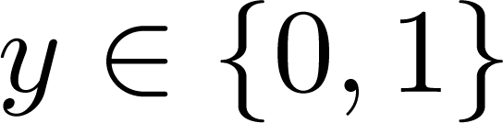
Classification (focus on binary classification)
Email: Spam / Not Spam?
Online Transactions: Fraudulent (Yes / No)?
Tumor: Malignant / Benign ?
0: “Negative Class” (e.g., benign tumor)
1: “Positive Class” (e.g., malignant tumor)

Slide 3

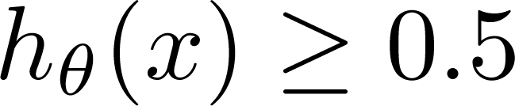
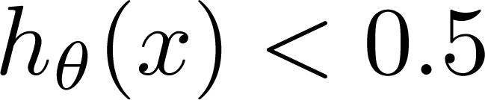
Consider linear regression again
(Yes) 1
Malignant ?
(No) 0
Tumor Size
Threshold classifier output at 0.5:
If , predict “y = 1”
If , predict “y = 0”

Slide 4
Consider linear regression again
(Yes) 1
Malignant ?
(No) 0
Tumor Size
Threshold classifier output at 0.5:
If , predict “y = 1”
If , predict “y = 0”

Slide 5
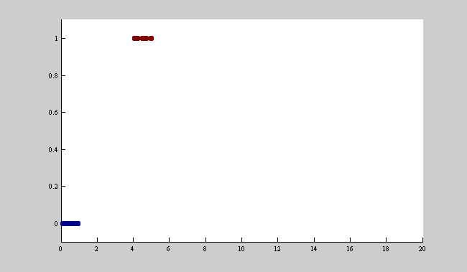
An easy 1D classification problem

Slide 6
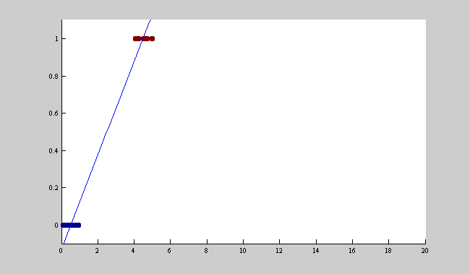
First Order Linear Regression Fit

Slide 7
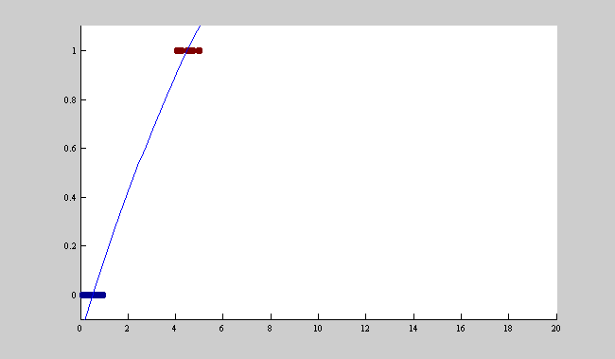
Second Order Fit

Slide 8
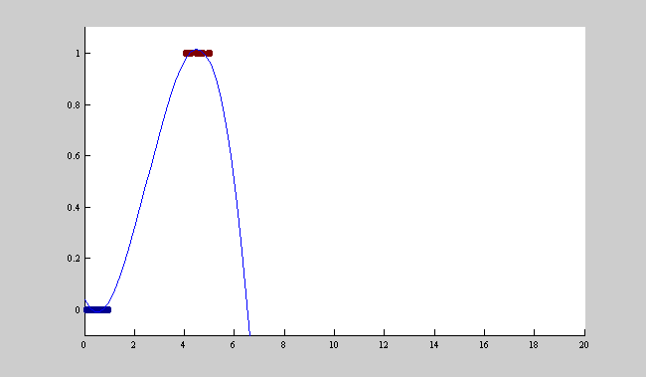
Third Order Fit

Slide 9
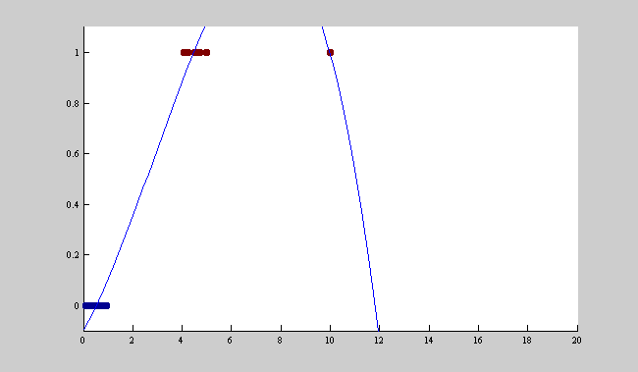
Third Order Fit + One More Point

Slide 10
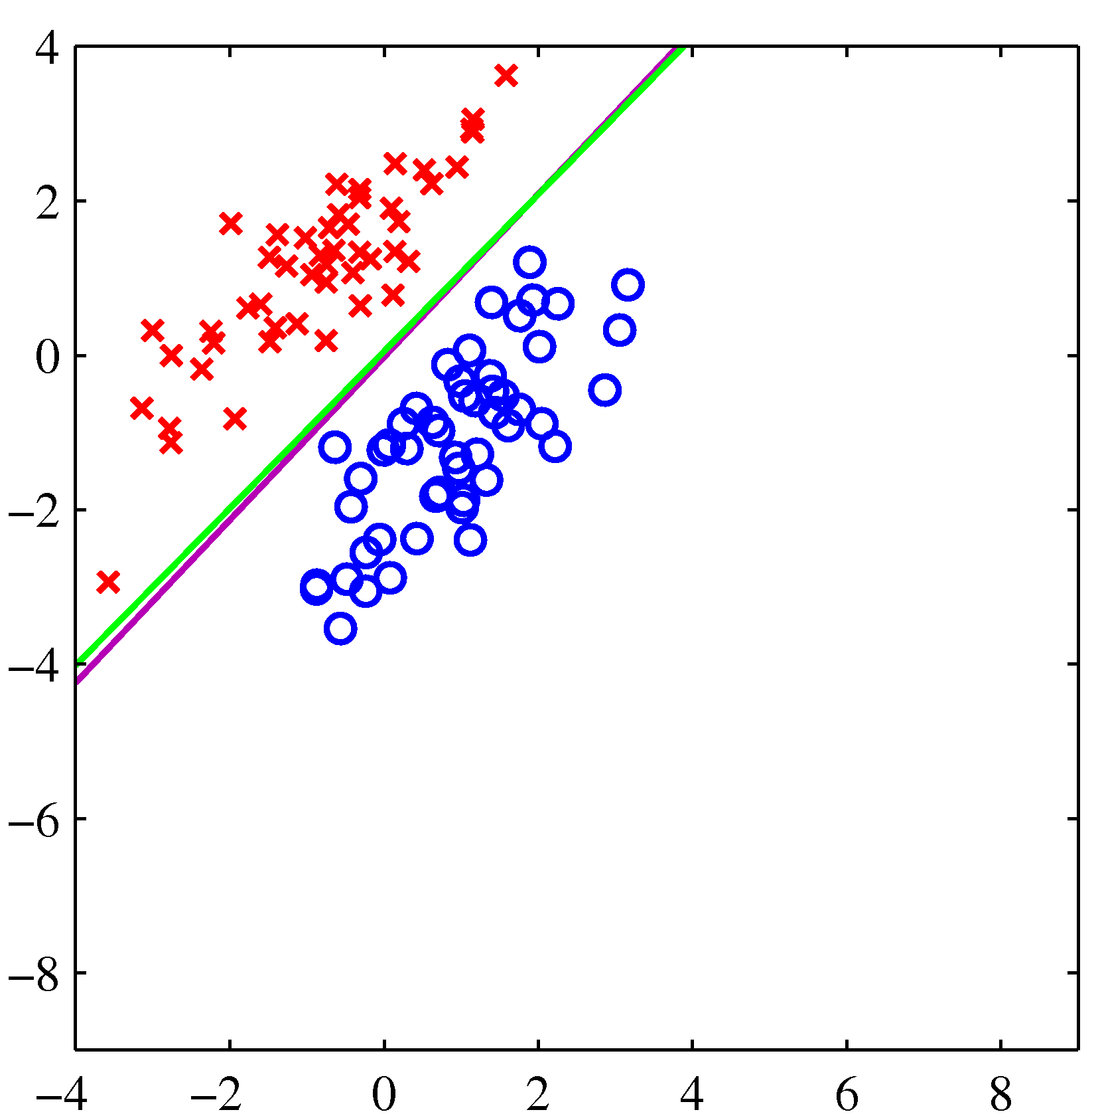
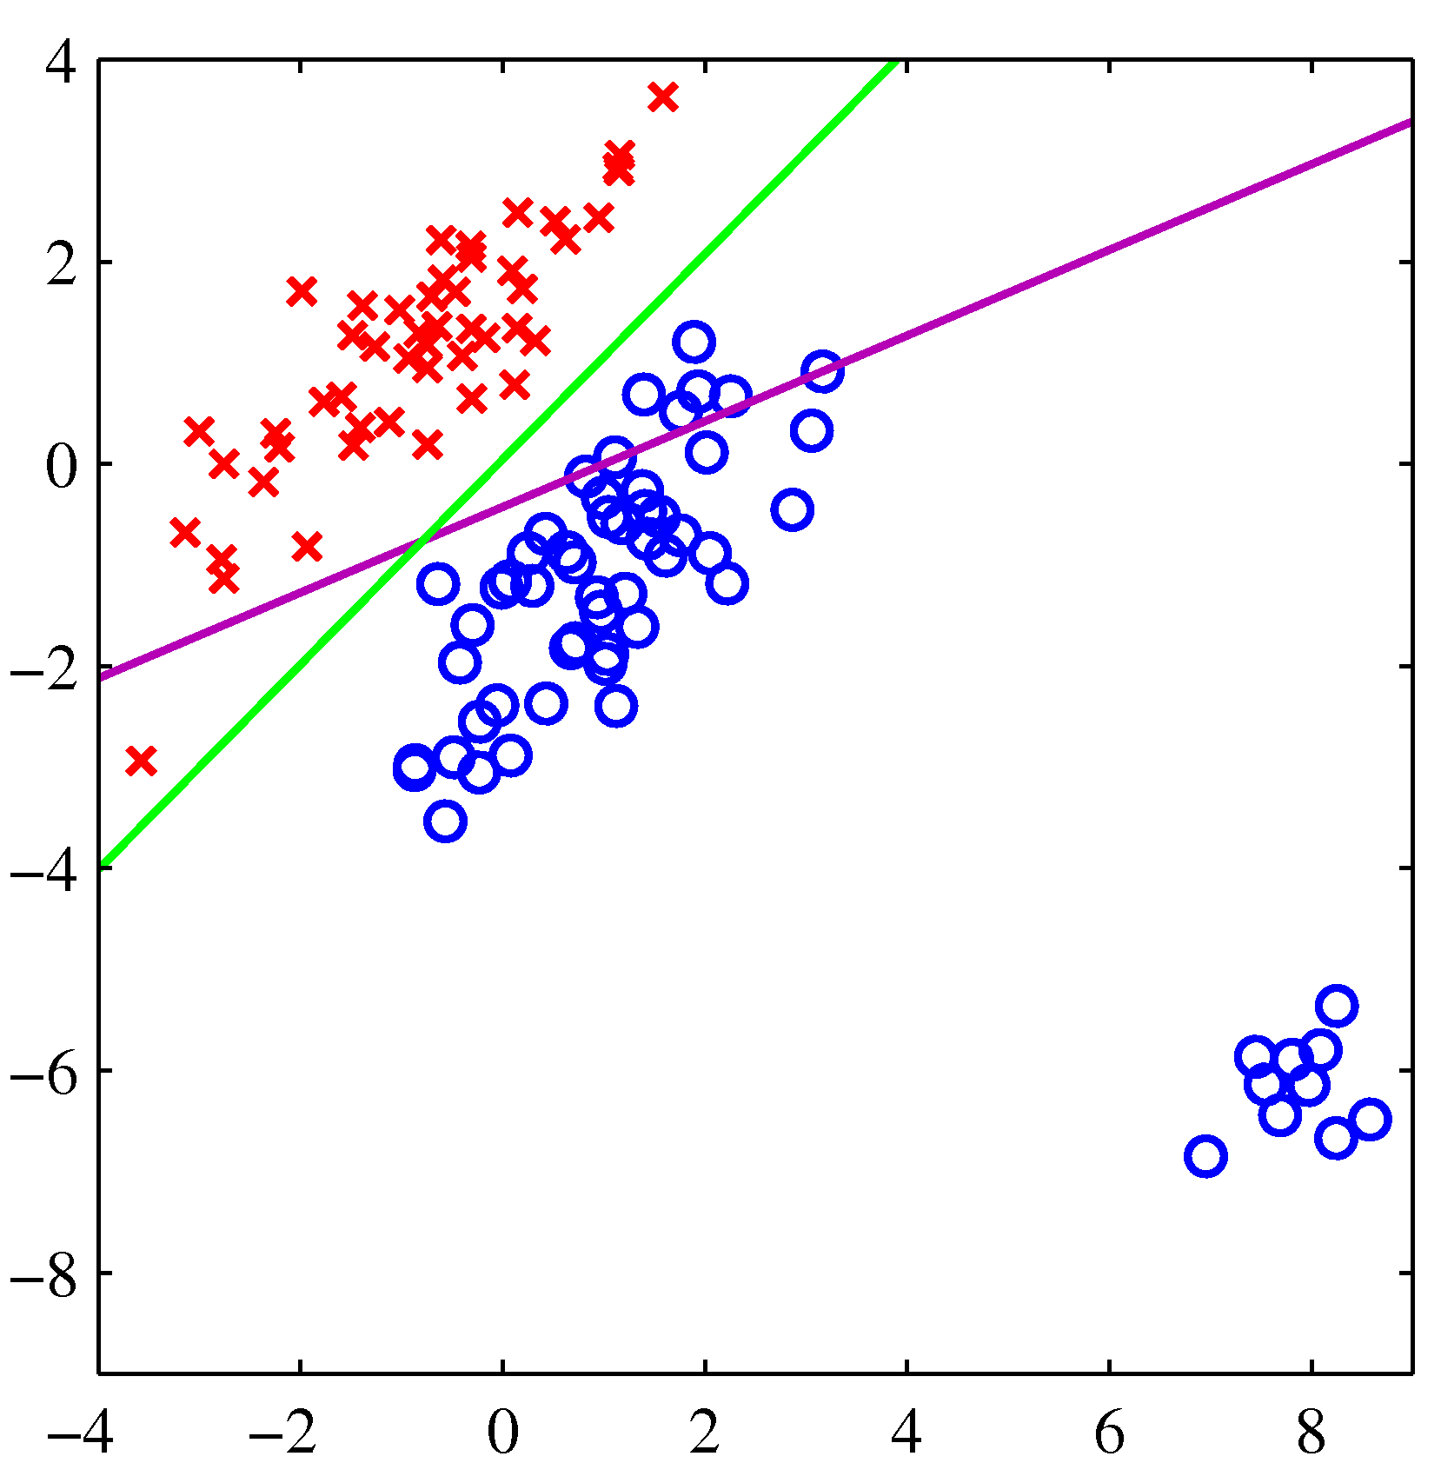
The same problem in 2D

Slide 11
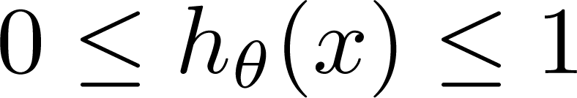
Hypothesis Representation and Loss Function
The linear regression loss function leads to poor performance for many classification problems
Logistic regression
Modify the hypothesis, replace the loss function
Keep everything else the same
Works much better in practice
Core idea: force hypotheses between 0 and 1
Logistic Regression:

Slide 12
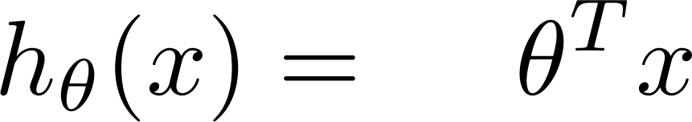
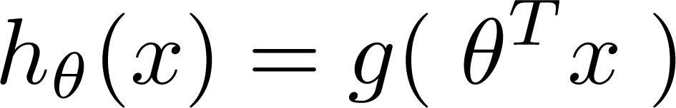
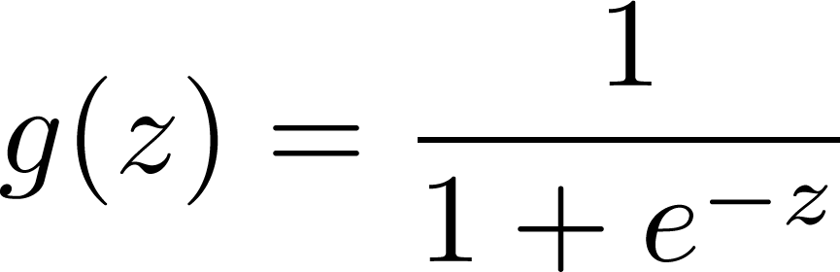
Logistic Regression Model
Want
1
Sigmoid function
Logistic function
0.5
0
Try the following in matlab:
ezplot(@(z) exp(-z))
ezplot(@(z) 1./(1+exp(-z)), [-10 10])

Slide 13
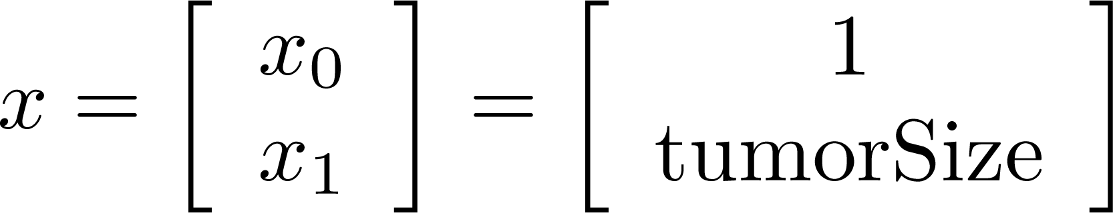
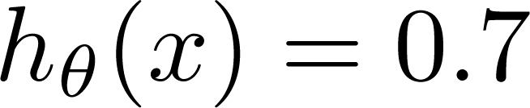
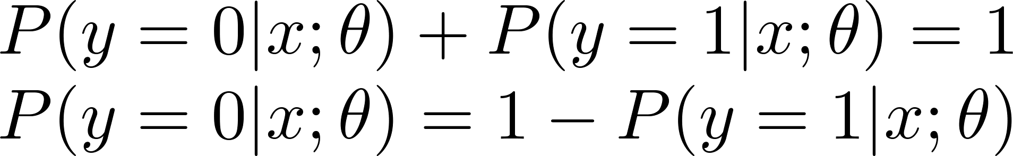
Interpretation of Hypothesis Output
= estimated probability that y = 1 on input x
Example: If
Tell patient that 70% chance of tumor being malignant
“probability that y = 1, given x,
parameterized by ”

Slide 14
Decision boundary
If false positives and false negatives are equally “costly”, then the decision boundary for any binary classifier is:
These are the same surface.

Slide 15

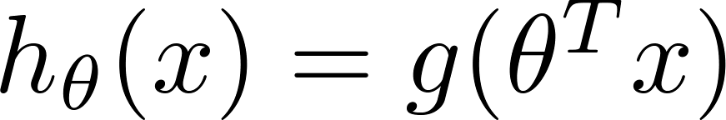
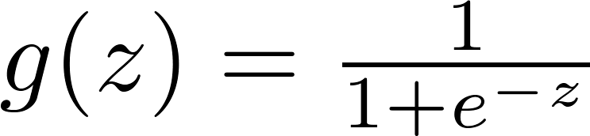

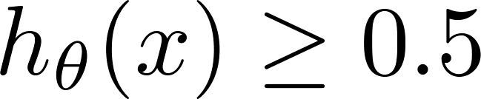

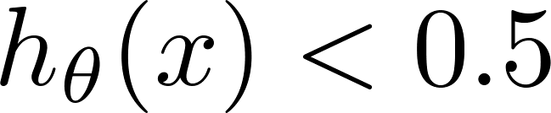
Logistic regression (activation and hypothesis)
1
z
Suppose predict “ “ if
predict “ “ if

Slide 16
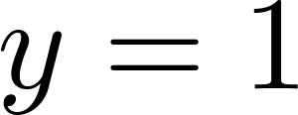
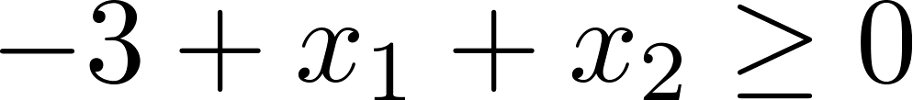
Linear Decision Boundary
x₂
3
2
1
-3
1
1
1
2
3
x₁
Predict “ “ if
Y=1, when X₁ + X₂ ≥ 3
Y=0, when X₁ + X₂ < 3

Slide 17
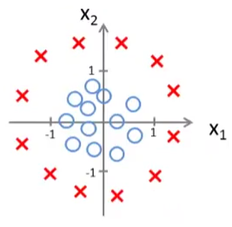
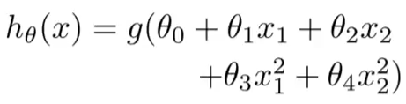
Non-linear decision boundaries
Let θ₀ = -1, θ₁ = 0, θ₂ = 0, θ₃ = 1, θ₄ = 1
X₁² + X₁² ≥ 1

Slide 18
Solving for the parameters
Similar to linear regression:
Define a cost function
Gather training data
Optimize parameters to fit the training data

Slide 19
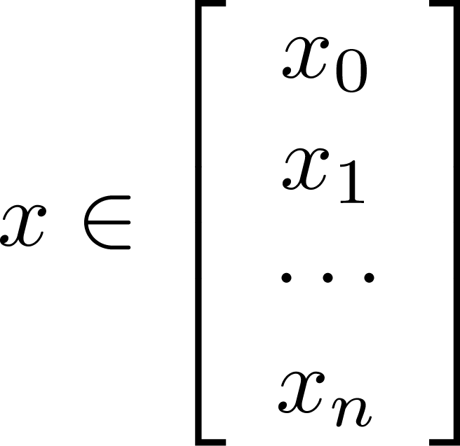
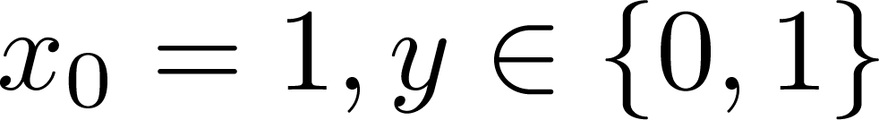
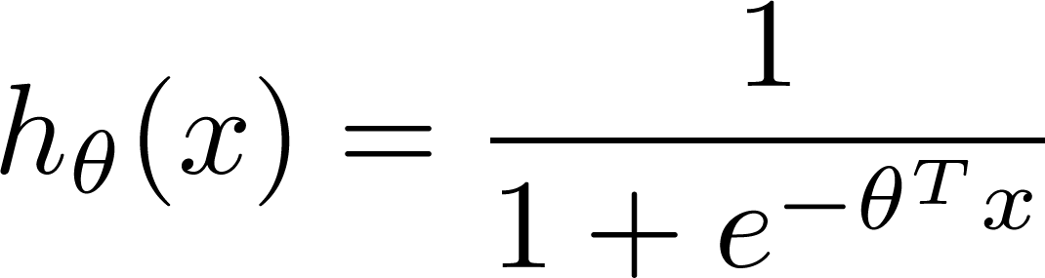

Training set:
m examples
How to choose parameters ?

Slide 20
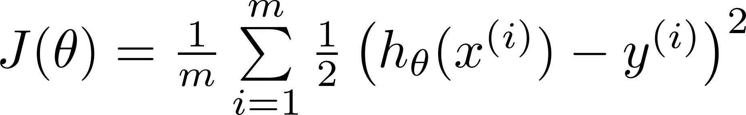

Can we just use least squares cost function?
Linear regression:
“non-convex”

Slide 21
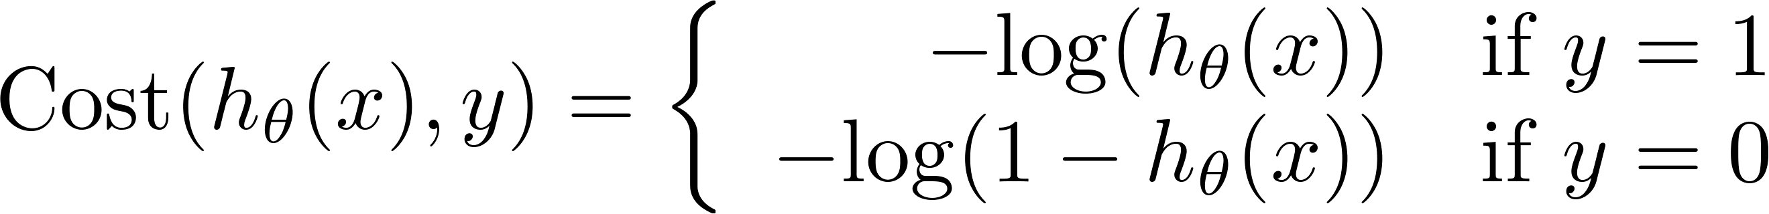
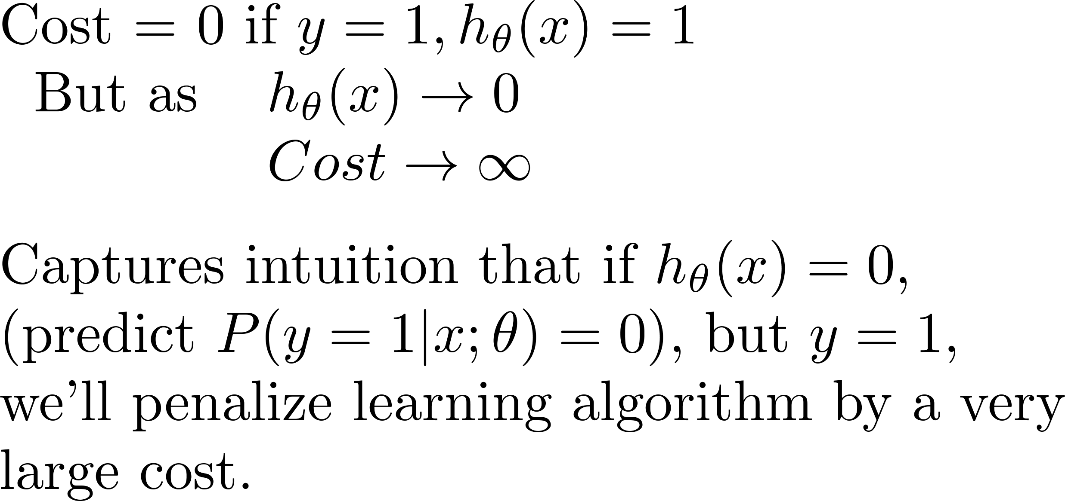
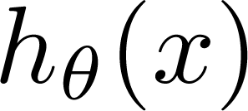
Logistic regression cost function
If y = 1
0
1

Slide 22
Logistic regression cost function
If y = 0
0
1

Slide 23
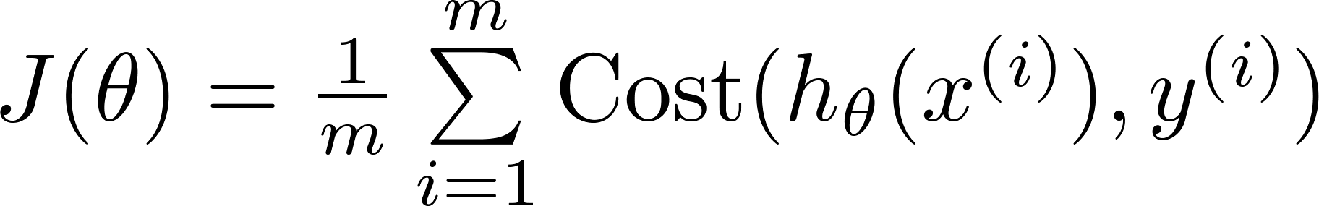

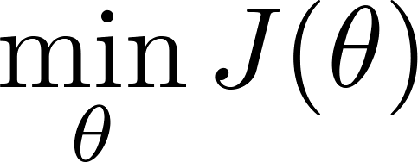

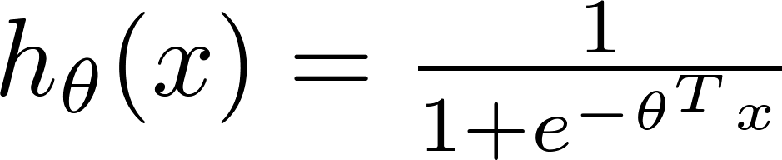
Logistic regression cost function
Since y = 0 or 1, we can write cost function as:
To fit parameters :
To make a prediction given new :
Output

Slide 24


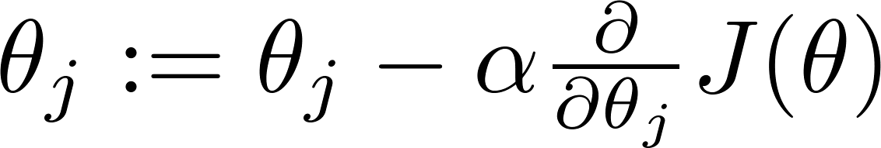


Gradient Descent
Want :
Repeat
(simultaneously update all )

Slide 25
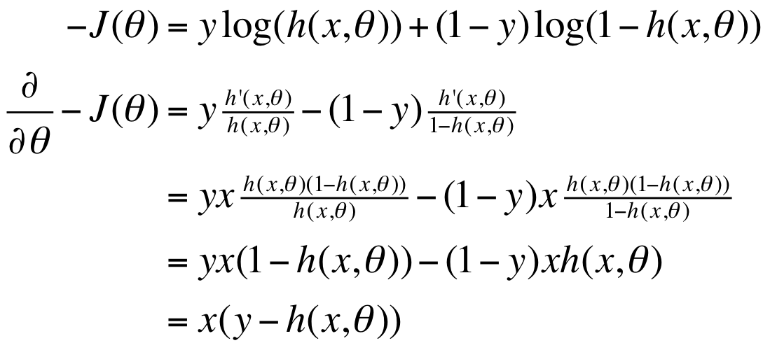

Gradient Computation
Given the following useful facts:
$$\frac{∂h(x,θ)}{∂θ}=xh(x,θ)(1−h\left(x,θ\right))$$
Compute symbolically using WolframAlpha
D[y*Log[1/(1+e^(a*x))] + (1-y)*Log[1 - 1/(1+e^(a*x))],a]

Slide 26
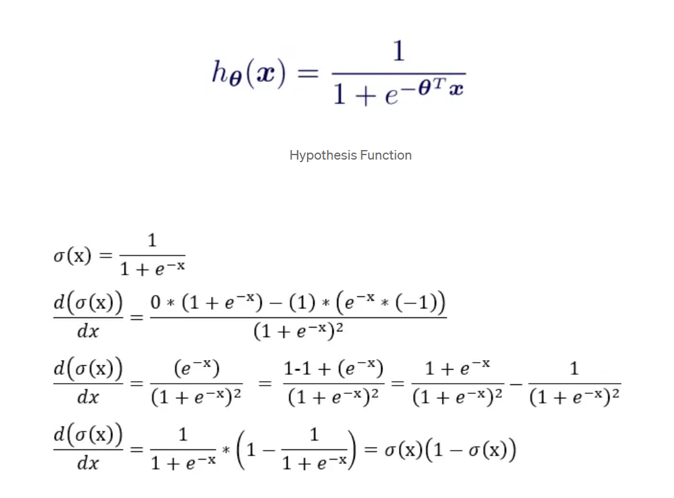

Slide 27
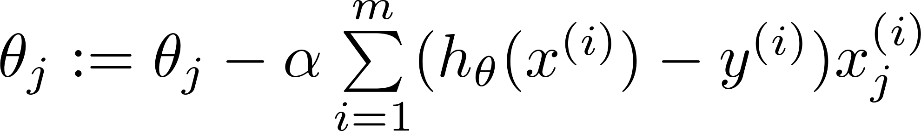
Gradient Descent
Want :
Repeat
(simultaneously update all )
Algorithm looks identical to linear regression!

Slide 28

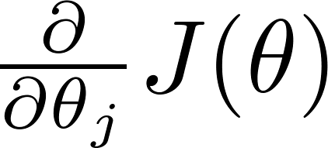
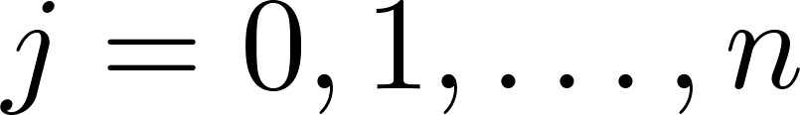
Basic Optimization Algorithm
Cost function . Want .
Given , we have code that can compute
(for )
Gradient descent:
Repeat

Slide 29
But many choices for optimization algorithm…
Given , we have code that can compute
(for )
Optimization algorithms:
Gradient descent
Advantages:
Often faster than gradient descent
No need to choose learning rate
Disadvantages:
More complex (but you don’t have to implement them!)
Conjugate gradient
BFGS
L-BFGS
http://docs.scipy.org/doc/scipy/reference/tutorial/optimize.html
http://www.mathworks.com/help/optim/ug/fminunc.html

Slide 30
Multi-Class Classification

Slide 31
Multiclass classification
Email foldering/tagging: Work, Friends, Family, Hobby
Medical diagrams: Not ill, Cold, Flu
Weather: Sunny, Cloudy, Rain, Snow

Slide 32
Binary classification:
Multi-class classification:
x₂
x₂
x₁
x₁

Slide 33
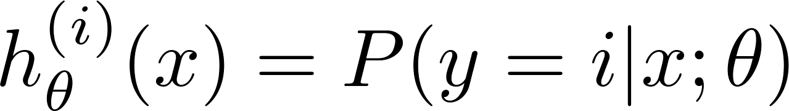

x₂
One-vs-all (one-vs-rest):
x₁
x₂
x₂
x₁
x₁
Class 1:
Class 2:
Class 3:
x₂
x₁

Slide 34
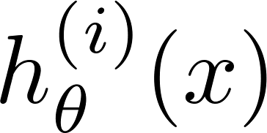

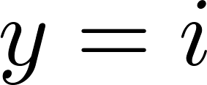
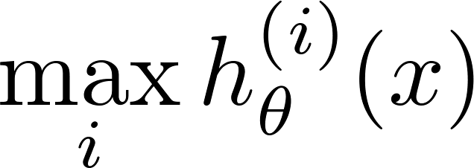
One-vs-all
Train a logistic regression classifier for each class to predict the probability that .
On a new input , to make a prediction, pick the class that maximizes

Slide 35
Summary
Logistic regression
for classification problems
simple optimization (similar to linear regression)
probabilistic output
non-linear decision boundaries

